Slide 1
LOGIN AND REGISTRATION SYSTEM
OOPS PROJECT
BY:-
BRITI SINGLA
CO21313
BE CSE 2ND SEM

Slide 2
overview
In the Login and Registration System a user than register themselves. After the registration the user can log in with their username and password. The system matches the login details with the registered details and allows or denies access according to the correctness of the details. If the user forgets his/her username and password, the account cannot be accessed. The program provides the user the chance to choose between login or registration or exiting the program.

Slide 3
Things used in the project
Classes
Objects and Functions
Loops – while loop with switch case
File handling – istream and ostream
Various Header files – iostream, fstream, cstring
Encapsulation

Slide 4
THE FILES
The registration data is stored in three separate files as shown in the next slide. The data is read from these files to match the registration details with the login details of the user.
The first one stores the Username created by the user. It is named loginuser.
The second one stores the Password set by the user. It is named as loginpass.
The third one stores the Name given by the user. It is names as loginname.

Slide 5
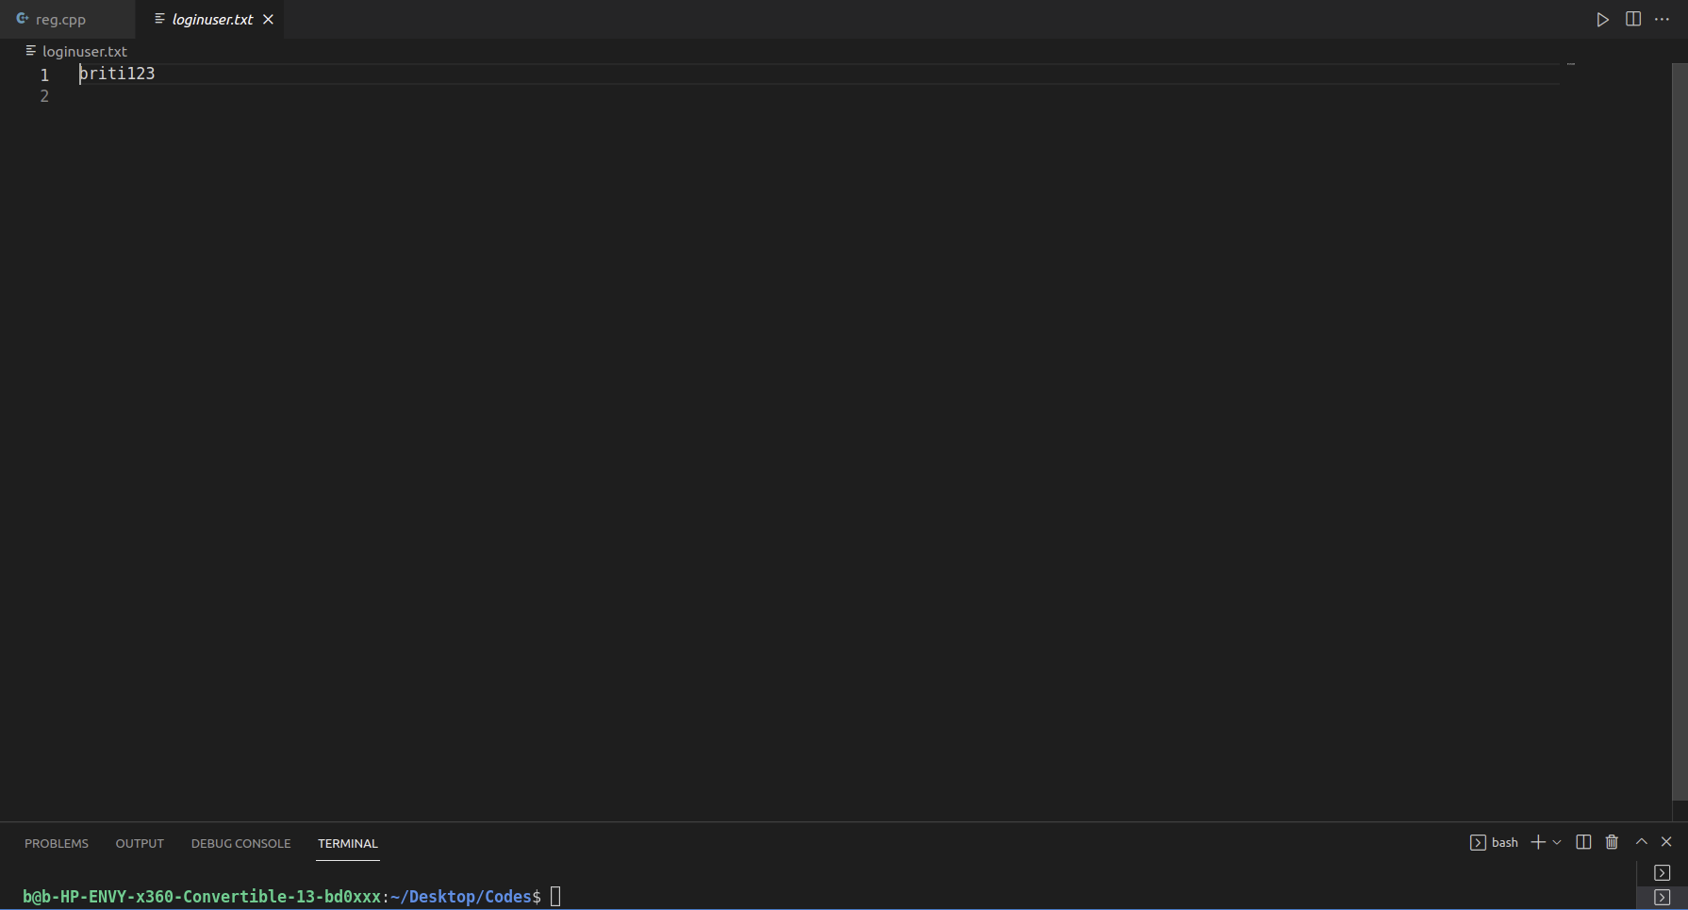



Slide 6
Working
The system gives the user an option between login(2), registration(1) or exiting the program (0).
It then displays the case for the selected option.
For registration, it asks the user to enter various details for username, password and name.
For login, it asks the user for username and password. If both the details are correct, then it shows successful login. If the details are incorrect, then it tells the user about it and sends them back to the menu.
For exit, it exits the program and tells the user goodbye.

Slide 7
Output
The next few slides show the output screen that is visible to the user.

Slide 8
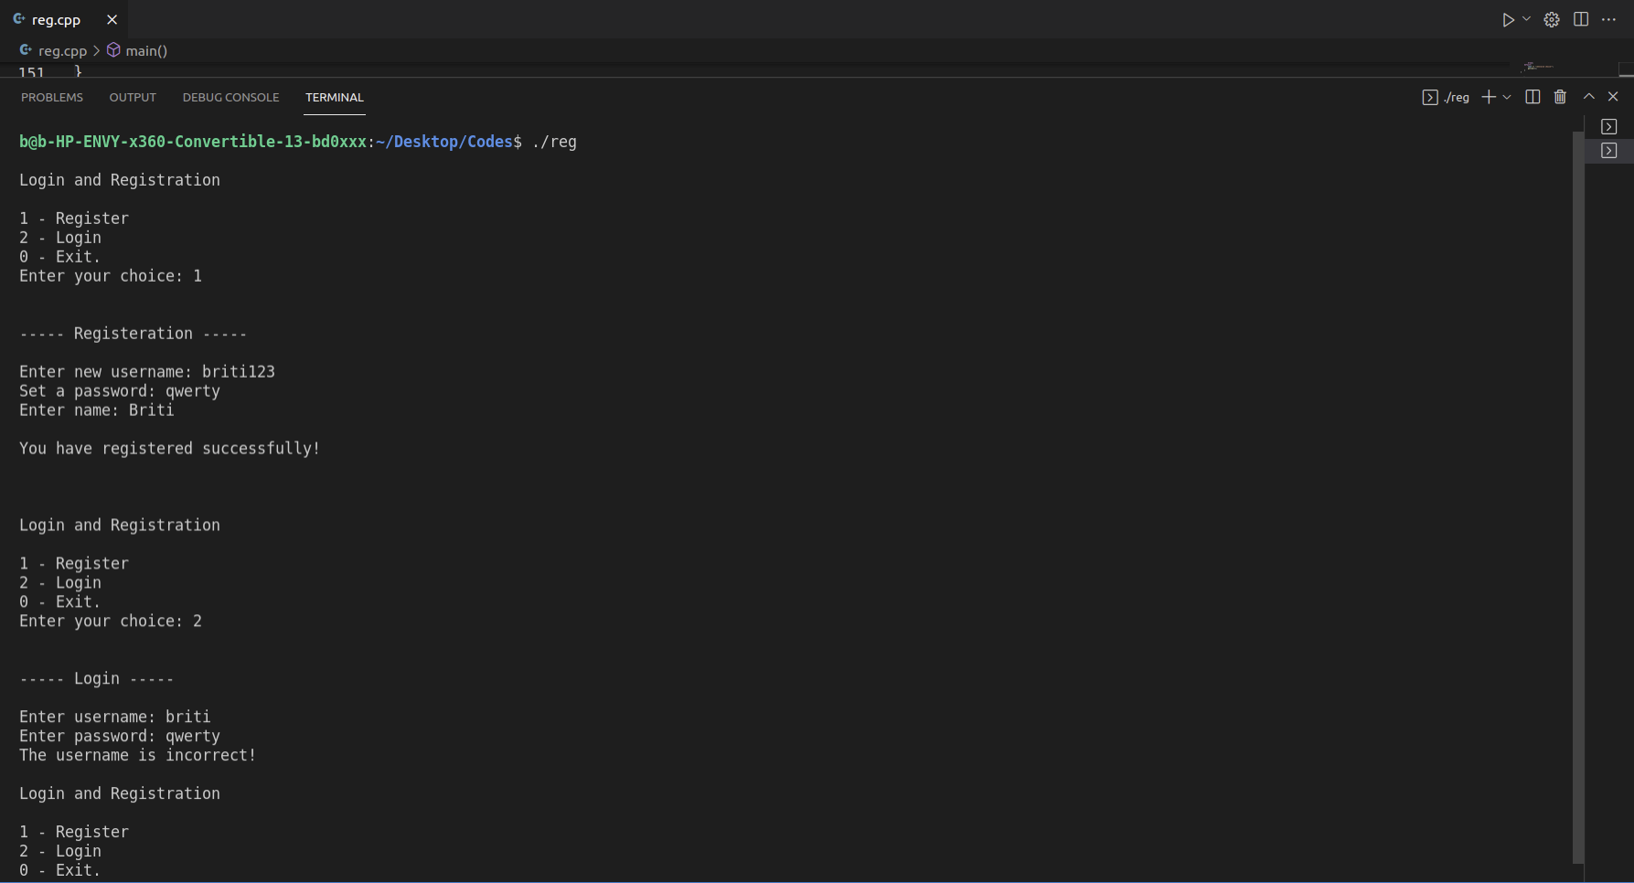

Slide 9
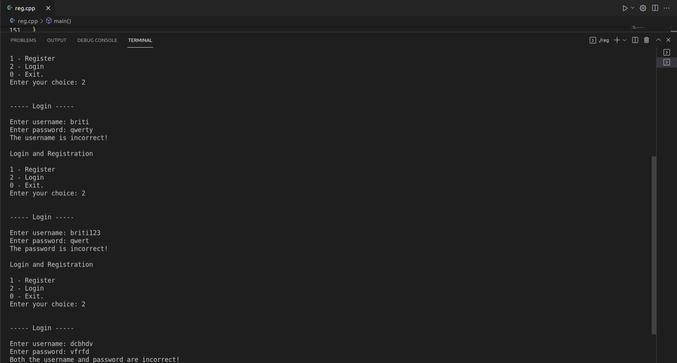

Slide 10
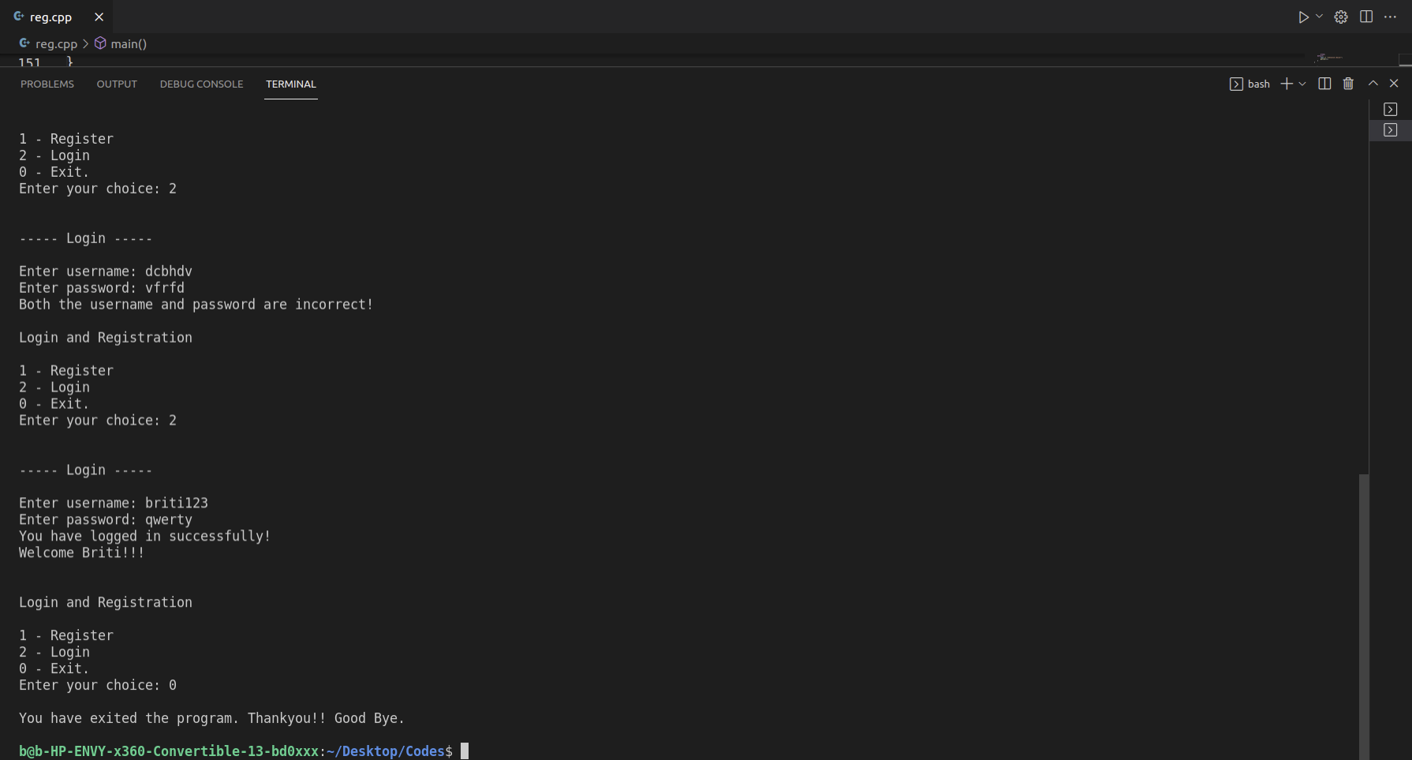

Slide 11
THANK YOU

